Slide 1
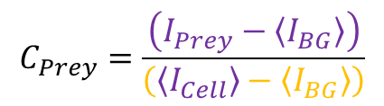
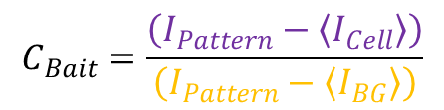


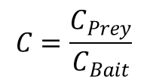
$$C_{Bait}=\frac{\left(I_{Pattern}−〈I_{Cell}〉\right)}{\left(I_{Pattern}−〈I_{BG}〉\right)}$$
$$C_{Bait}≅0→highly nonspecific$$
$$C_{Bait}≅1→highly specific$$
$$C_{Prey}=\frac{\left(I_{Prey}−〈I_{BG}〉\right)}{\left(〈I_{Cell}〉−〈I_{BG}〉\right)}$$
$$C=\frac{C_{Prey}}{C_{Bait}}$$
Final Contrast:

